Slide 1
Resource Usage Inference via program analysis
Yue Duan, Heng Yin
University of California, Riverside

Slide 2
Problem Statement
Given an Android/Java application, we would like to infer fine-graind hardware and software resource usage information at DFU level.
To know how applications could function normally under envrionment changes, we need to understand the resource requirements for each of its components.
Resource usage information is essential for generating resource profiles and annotating DFUs for later steps in the whole project.

Slide 3
Overview
Challenges
identify hardware resource dependency
quantify resource uages
input dependent resource usage analysis
input value
input size
Benefits:
understand what kinds of resource are required for each DFU
hardware resource such as GPS satelite
software resource such as third-party libs
know how much resource is needed in order to execute DFU
how much memory is needed to run one DFU
perceive how data is transitted accross DFUs and non-DFUs
extract resource usage information in a more accurate fasion by considering input size and value
image size will affect resource usages a lot given a image processing app
different input values may lead the app executing different paths resulting in a completely different resource usages

Slide 4
Overview
To address the aforementioned challenges, our whole system is designed to have three different subsystems (DroidScope, Symbolic execution and DroidSIFT) to perform four analyses.
The results are post-processed and eventually stored in our triple store for future query.

Slide 5
Approach
Resource dependency
Goal: understand what resources are used by DFUs
identify sensitive APIs related to certain hardware, e.g. android.bluetooth.BluetoothAdapter.getAdapter() for bluetooth
one-time effort, from our domain knowledge about Android
analyze the application statically with domain knowledge to infer hardware resource dependency
Resource usage quantification
Goal: quantify certain hardware resource usages
pinpoint hooking points during execution for resource usage quantification
for example
hook each instruction for CPU usage info
hook memory allocation function for memory usage info
achieve fine-grained usage analysis at function level or DFU level
may suffer from code-coverage issue

Slide 6
Approach
Impact of input size
Goal: evaluate how input size affects resoure usages
run the application against multiple inputs with different sizes
inputs are currently generated manually case by case
collect resource usage information for each input
evaluate the impact of input size for resource usages by modeling the results
Impact of input value
Goal: understand how input value affects application execution and resource usages
use symbolic execution and condition anlaysis to understand the code coverage of each individual input
understand how different execution paths could affect resource usages
research focus for the next phase

Slide 7
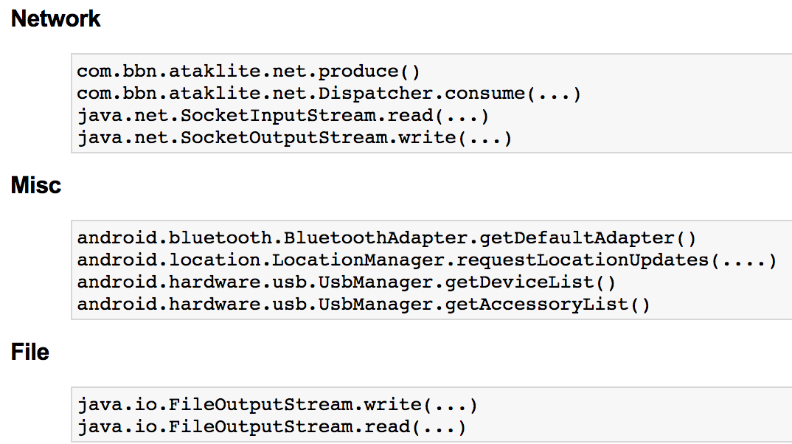
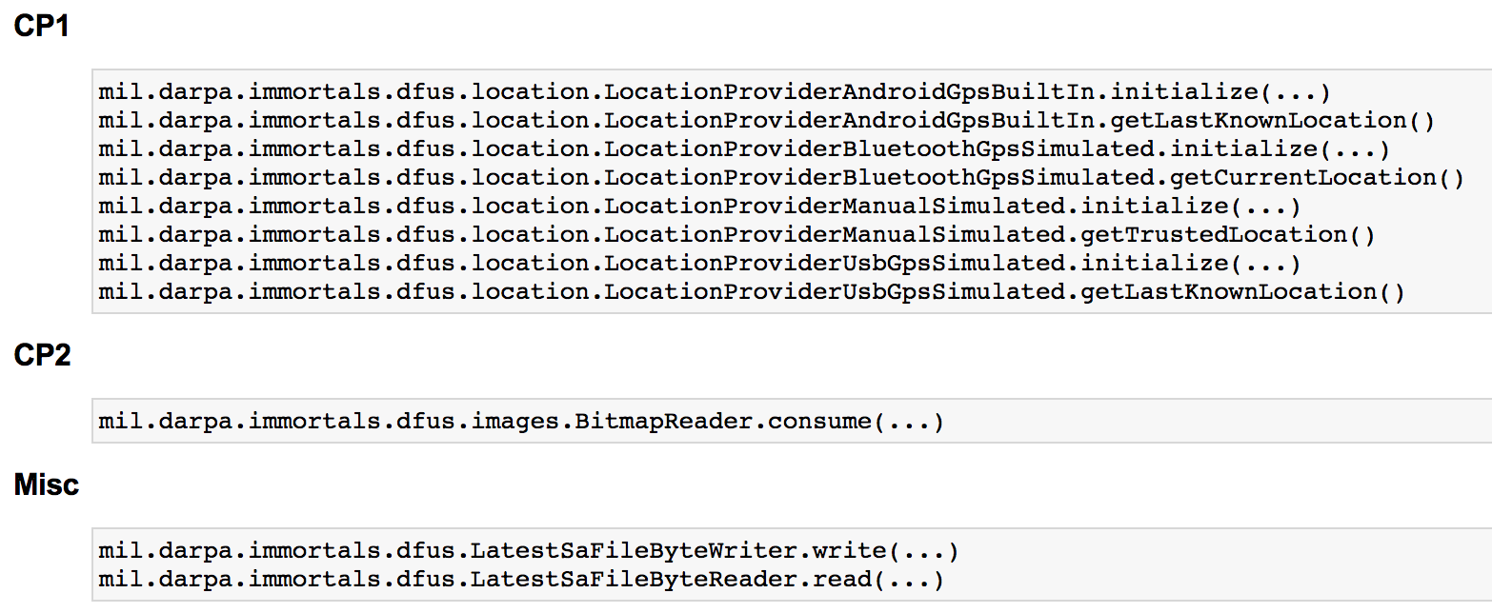
Approach
Resource data transition analysis
Goal: Find out how resource data is transited within application
manually define a list of DFU functions as starting points and end points
starting points: DFU functions that produce the resource data
end points: DFU or non-DFU functions that consume the data
extract a complete call graph and class hierarchy for the whole application
use those extracted info to get all paths from starting to end points

Slide 8
Current Status
Things done:
developed a tool named DroidSIFT to identify hardware resource dependency for GPS satellite and bluetooth
implemented a plugin on top of DroidScope to quantify resource usages for CPU and memory
combined call graph and predefined sources and sinks to understand how resource data is used across different DFUs and non-DFUs
developed an automatic testing environment for executing multiple inputs with different sizes and collected results for analysis
In progress
seeking different techniques to understand the impact of input values
combining the results from above analyses to deliver the resource profiles

